Slide 1
Digital Data to Analog Signal

Slide 2
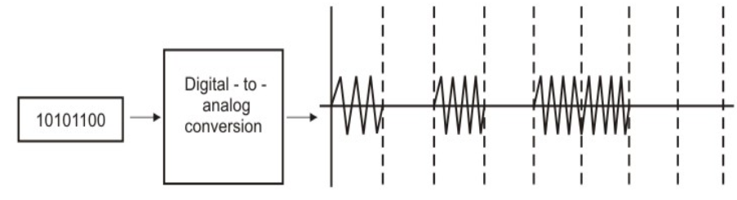
When?
Essential for scenarios like telephone network.
Conversion is accomplished with the help of special devices such as modem (modulator-demodulator).

Slide 3
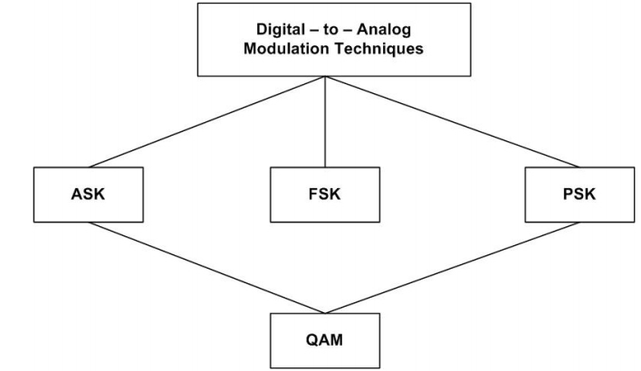
Modulation Techniques
Modulation techniques involved:
Amplitude shift keying (ASK),
Frequency shift keying (FSK) and
Phase shift keying (PSK),
There are many situations where ASK and PSK techniques are combined together to form Quadrature Amplitude Modulation (QAM).

Slide 4
Amplitude-shift keying (ASK)
2 binary values are represented by two different amplitudes of the carrier frequency.
The unmodulated carrier can be represented by e_{c}(t) = E_{c} cos 2πf_{c}t
The modulated signal can be written as s(t) = k e_{m} cos 2πf_{c}t s(t) = A₁cos 2πf_{c}t for 1 s(t) = A₂cos 2πf_{c}t for 0

Slide 5
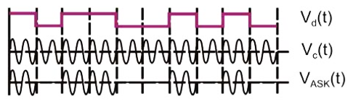
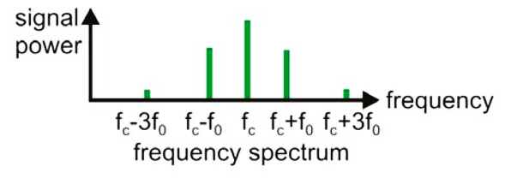
Amplitude-shift keying (ASK)

Slide 6
Amplitude-shift keying (ASK)
Special case: On/Off Keying (OOK),
the amplitude A₂ = 0
ASK is susceptible to sudden gain changes and OOK is commonly used to transmit digital data over optical fibers.
Frequency Spectrum:
If B_{m} is the overall bandwidth of the binary signal, the bandwidth of the modulated signal is B_{T} = N_{b}, where N_{b} is the baud rate.

Slide 7
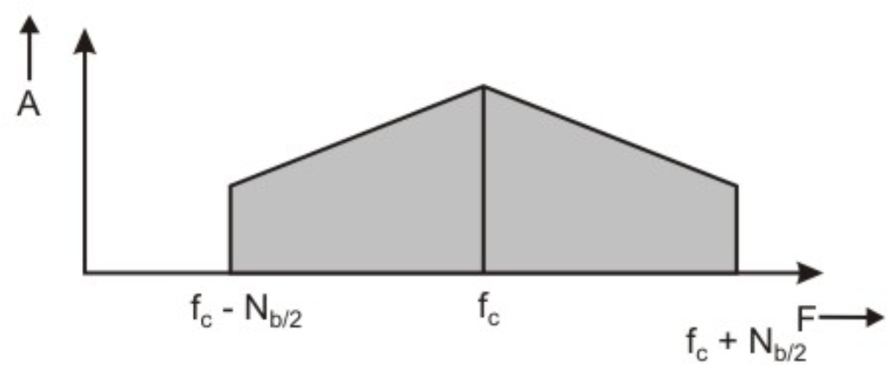
Amplitude-shift keying (ASK)

Slide 8
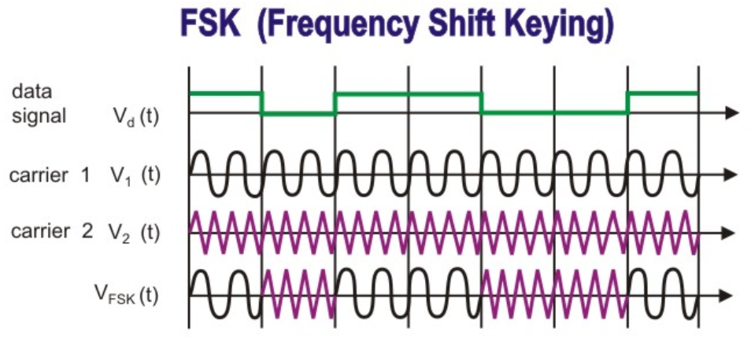
Frequency-Shift Keying (FSK)
Two binary values are represented by two different frequencies near the carrier frequencies

Slide 9
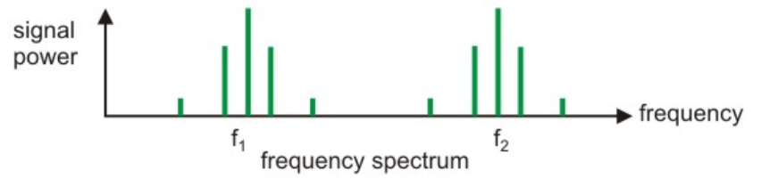
Frequency-Shift Keying (FSK)
Two carrier frequencies f₁ and f₂ are used to represent 1 and 0
Here s(t) = A cos 2πf_{c1}t for binary 1 And s(t) = A cos 2πf_{c2}t for binary 0
This method is less susceptible to errors than ASK.
It is mainly used in higher frequency radio transmission.

Slide 10
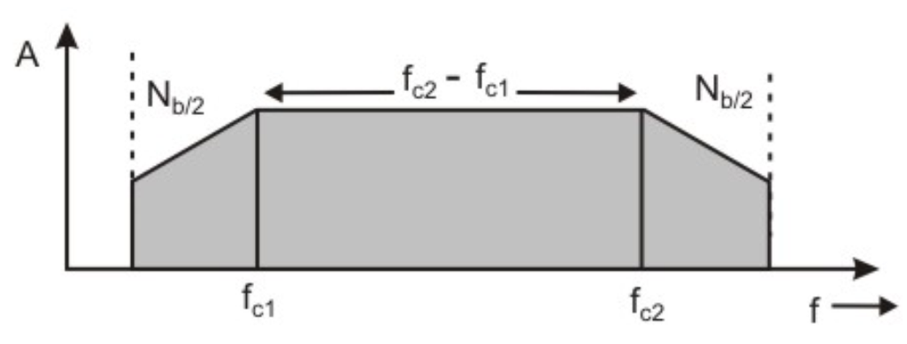
Frequency-Shift Keying (FSK)
Frequency spectrum:
FSK may be considered as a combination of two ASK spectra centered around f_{c1} and f_{c2}, which requires higher bandwidth. The bandwidth = (f_{c2} - f_{c1})+ N_{b}

Slide 11
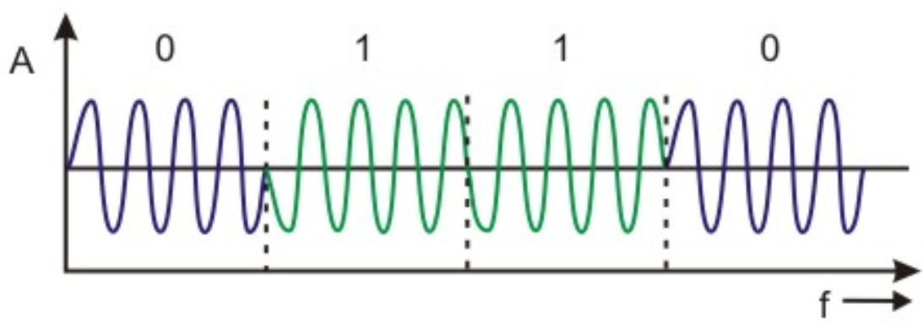
Phase Shift Keying (PSK)
The phase of the carrier signal is shifted by the modulating signal with the phase measured relative to the previous bit interval.
The binary 0 is represented by sending a signal of the same phase as the preceding one and 1 is represented by sending the signal with an opposite phase to the previous one.

Slide 12
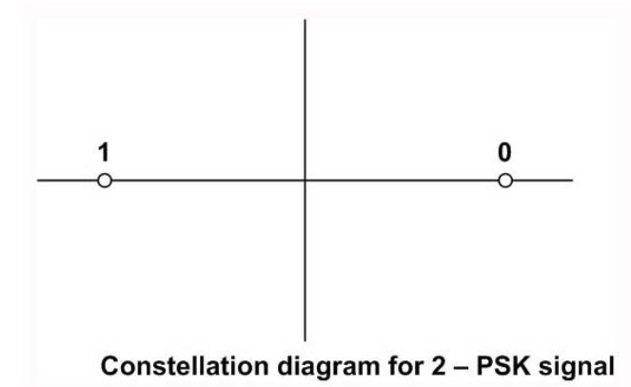
2-PSK
In 2-PSK the carrier is used to represent 0 or 1.
s(t) = A cos (2πfct + π) for binary 1
s(t) = A cos (2πfct) for binary 0
The signal set can be shown geometrically and is called a Constellation diagram for 2-PSK signal
In this method, the phase of the carrier signal is shifted by phase measured relative to the previous bit interval.
The binary 0 is represented by sending a signal of the same phase as the preceding one and
1 is represented by sending the signal with an opposite phase to the previous one

Slide 13
Constellation Diagram
A constellation diagram provides a graphical representation of the complex envelope of each possible symbol state.
The x-axis of a constellation diagram represents the in-phase component of the complex envelope, and the y-axis represents the quadrature component of the complex envelope.
The distance between signals on a constellation diagram indicates how different the modulation waveforms are, and how well a receiver can differentiate between all possible symbols in presence of noise

Slide 14
M-ary Modulation
Instead of just varying phase, frequency or amplitude of the RF signal, modern modulation techniques allow both envelope(amplitude) and phase (or frequency) of the RF carrier to vary.
Because the envelope and phase provide two degrees of freedom, such modulation techniques map baseband data into four or more possible RF carrier signals. Such modulation techniques are known as M-ary modulation.

Slide 15
M-ary Modulation
In M-ary modulation scheme, two or more bits are grouped together to form symbols and one of possible signals S₁(t), S₂(t), …, S_{m}(t) is transmitted during each symbol period T_{s}.
Normally, the number of possible signals is M = 2^{n}, where n is an integer.
Depending on whether the amplitude, phase or frequency is varied, the modulation is referred to as M-ary ASK, M-ary PSK or M-ary FSK.
M-ary modulation technique attractive for use in bandlimited channels, because these techniques achieve better bandwidth efficiency at the expense of power efficiency.
For example, an 8-PSK technique requires a bandwidth that is log₂8 = 3 times smaller than 2-PSK (also known as BPSK) system.
However, M-ary signalling results in poorer error performance because of smaller distances between signals in the constellation diagram.

Slide 16
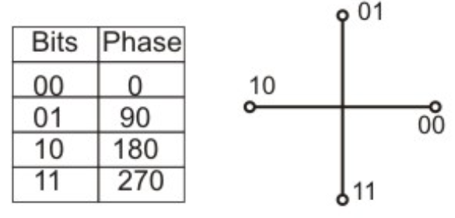
Quadrature Phase Shift Keying (QPSK)
QPSK can be used for more efficient use of bandwidth
s(t) = A cos (2πf_{c}t) for 00 = A cos (2πf_{c}t + 90) for 01
= A cos (2πf_{c}t + 180) for 10 = A cos (2πf_{c}t + 270) for 11
Here phase shift occurs in multiple of 90° as shown in constellation diagram

Slide 17
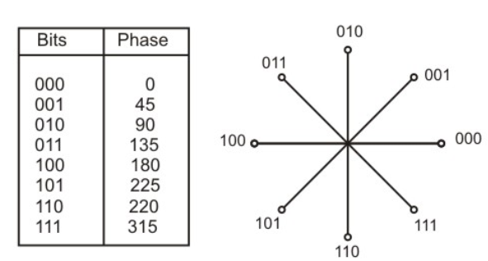
8-PSK

Slide 18
QAM (Quadrature Amplitude Modulation)
Ability of equipment to distinguish small differences in phase, limits the potential bit rate.
This can be improved by combining ASK and PSK which results in QAM.
It is possible to obtain higher data rate using QAM.
It may be noted that M-ary QAM does not have constant energy per symbol, nor does it have constant distance between possible symbol values.

Slide 19
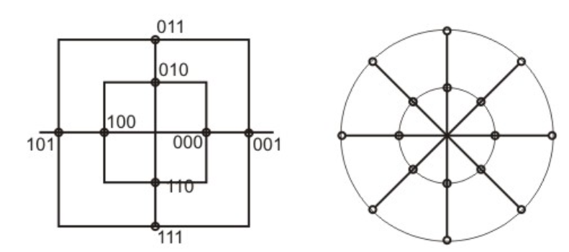
QAM (Quadrature Amplitude Modulation)
The constellation diagram of a QAM signal with two amplitude levels and four phases is:

Slide 20
Bit rate and Baud rate
Use of different modulation techniques lead to different baud rates (number of signal elements per second) for different values of bit rates, which represents the numbers of data bits per second.
Same baud rate allows different bit rates for different modulation techniques.
The baud rate, implies the bandwidth requirement of the medium used for transmission of the analog signal.

Slide 21
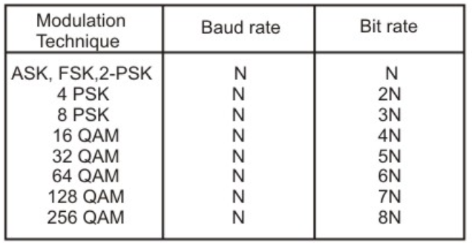
Bit rate and Baud rate

Slide 22
Multiplexing of Signals

Slide 23
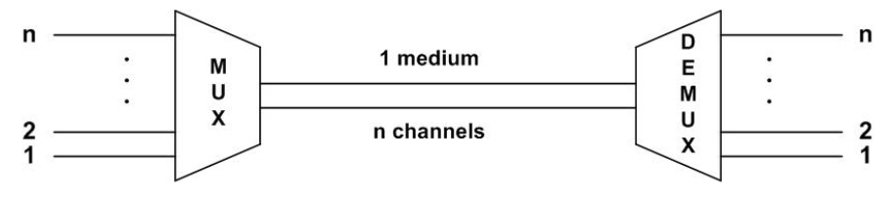
Multiplexing
The process of making the most effective use of the available channel capacity, by sharing a medium by more than one channel of signals is called Multiplexing.
Most common use of multiplexing is in long-haul communication using coaxial cable, microwave and optical fibre.

Slide 24
Multiplexing
Multiplexing techniques can be categorized into the following three types:
Frequency-division multiplexing (FDM):
Most popular and is used extensively in radio and TV transmission.
Frequency spectrum is divided into several logical channels, giving each user exclusive possession of a particular frequency band.
Time-division Multiplexing (TDM):
Also called synchronous TDM
commonly used for multiplexing digitized voice stream.
The users take turns using the entire channel for short burst of time
Statistical TDM :
Also called asynchronous TDM,
simply improves on the efficiency of synchronous TDM.

Slide 25
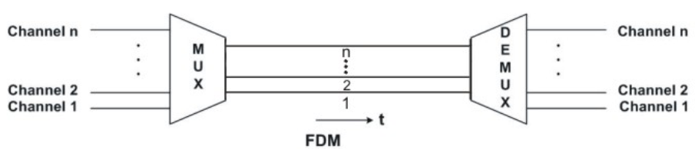
Frequency-Division Multiplexing (FDM)
Available bandwidth of a single physical medium is subdivided into several independent frequency channels
Independent message signals are translated into different frequency bands using modulation techniques, which are combined by a linear summing circuit in the multiplexer, to a composite signal

Slide 26
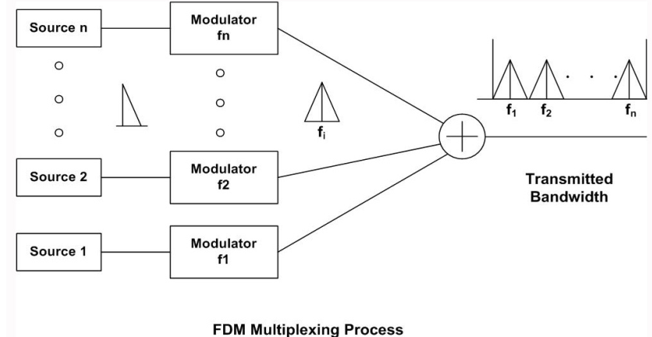
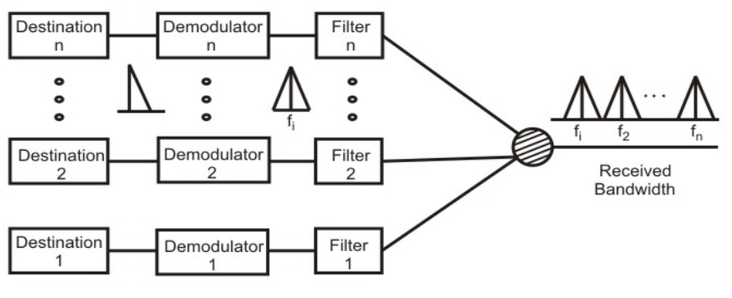

Slide 27
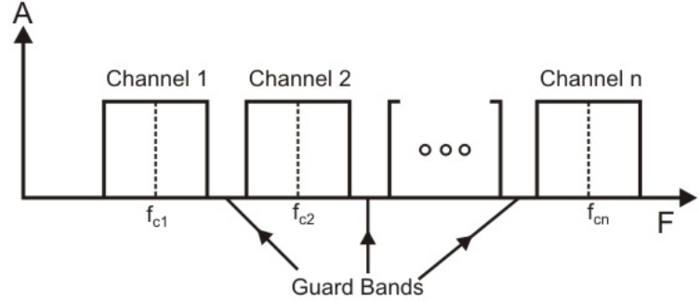
Guard Bands
If the channels are very close to one other, it leads to inter-channel cross talk.
Channels must be separated by strips of unused bandwidth to prevent inter-channel cross talk.
These unused channels between each successive channel are known as guard bands

Slide 28
Wavelength-Division Multiplexing
conceptually same as the FDM,
except that the multiplexing and demultiplexing involves light signals transmitted through fibre-optic channels.
The idea is the same: we are combining different frequency signals.
However, the difference is that the frequencies are very high.
It is designed to utilize the high data rate capability of fibre-optic cable.
Very narrow band of light signal from different source are combined to make a wider band of light.
At the receiver the signals are separated with the help of a demultiplexer

Slide 29
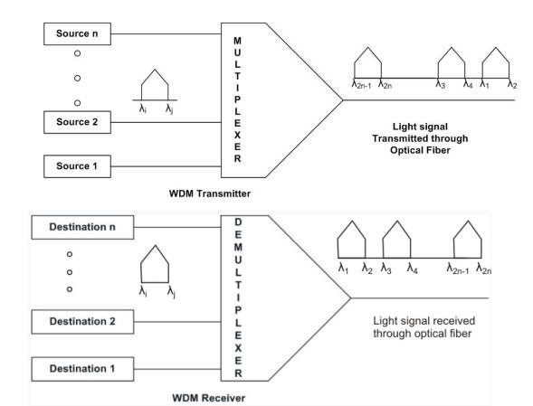

Slide 30
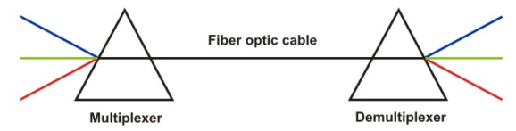
Wavelength-Division Multiplexing
Multiplexing and demultiplexing of light signals can be done with the help of a prism.
From the basic knowledge of physics we know that light signal is bent by different amount based on the angle of incidence and wavelength of light as shown by different colours in the figure.
One prism performs the role of a multiplexer by combining lights having different frequencies from different sources.
The composite signal can be transmitted through an optical fibre cable over long distances, if required.
At the other end of the optical fibre cable the composite signal is applied to another prism to do the reverse operation, the function of a demultiplexer.

Slide 31
Time-Division Multiplexing (TDM)
All signals operate with same frequency at different times
An electronic commutator sequentially samples all data source and combines them to form a composite base band signal, which travels through the media and is being demultiplexed into appropriate independent message signals by the corresponding commutator at the receiving end.
The incoming data from each source are briefly buffered.
Each buffer is typically one bit or one character in length.
The buffers are scanned sequentially to form a composite data stream.
The scan operation is sufficiently rapid so that each buffer is emptied before more data can arrive.
Composite data rate must be at least equal to the sum of the individual data rates.
The composite signal can be transmitted directly or through a modem.

Slide 32
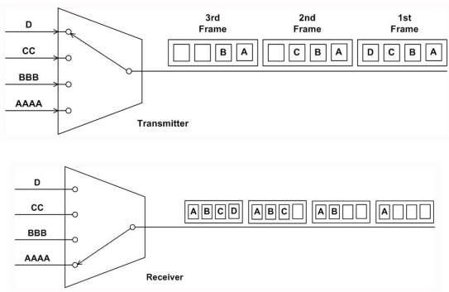

Slide 33
Time-Division Multiplexing (TDM)
The composite signal has some dead space between the successive sampled pulses, which is essential to prevent inter-channel cross talks.
Along with the sampled pulses, one synchronizing pulse is sent in each cycle which along with the control information form a frame.
Each of these frames contain a cycle of time slots and in each frame, one or more slots are dedicated to each data source.
The maximum bandwidth (data rate) of a TDM system should be at least equal to the same data rate of the sources.
Synchronous TDM is called synchronous mainly because each time slot is preassigned to a fixed source.

Slide 34
Time-Division Multiplexing (TDM)
The time slots are transmitted irrespective of whether the sources have any data to send or not.
Hence, for the sake of simplicity of implementation, channel capacity is wasted.
Although fixed assignment is used TDM, devices can handle sources of different data rates.
This is done by assigning fewer slots per cycle to the slower input devices than the faster devices.
Both multiplexing and demultiplexing operation for synchronous TDM

Slide 35
Statistical Time-division Multiplexing
One drawback of the TDM approach is that many of the time slots in the frame are wasted.
If a terminal has no data to transmit at particular instant of time, an empty time slot will be transmitted.
An efficient alternative to this synchronous TDM is statistical TDM, also known as asynchronous TDM or Intelligent TDM.
It dynamically allocates the time slots on demand to separate input channels, thus saving the channel capacity.
As with Synchronous TDM, statistical multiplexers also have many I/O lines with a buffer associated to each of them.
During the input, the multiplexer scans the input buffers, collecting data until the frame is filled and send the frame.

Slide 36
Statistical Time-division Multiplexing
At the receiving end, the demultiplexer receives the frame and distributes the data to the appropriate buffers.
It may be noted that many slots remain unutilised in case synchronous TDM, but the slots are fully utilized leading to smaller time for transmission and better utilization of bandwidth of the medium.
In case of statistical TDM, the data in each slot must have an address part, which identifies the source of data.
Since data arrive from and are distributed to I/O lines unpredictably, address information is required to assure proper delivery which leads to more overhead per slot.
Relative addressing can be used to reduce overhead

Slide 37
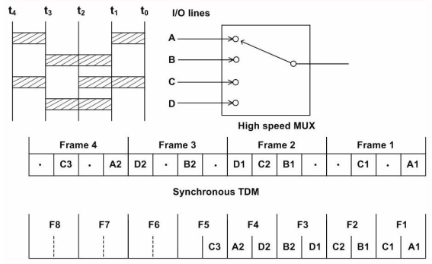

Slide 38
Orthogonal Frequency Division Multiplexing
FDM transmits multiple signals simultaneously over a single transmission path.
Each signal travels within its own unique frequency range (carrier), which is modulated by the data.
Orthogonal FDM's (OFDM) spread spectrum technique distributes the data over a large number of carriers that are spaced apart at precise frequencies.
This spacing provides the "orthogonality" in this technique, which prevents the demodulators from seeing frequencies other than their own.

Slide 39
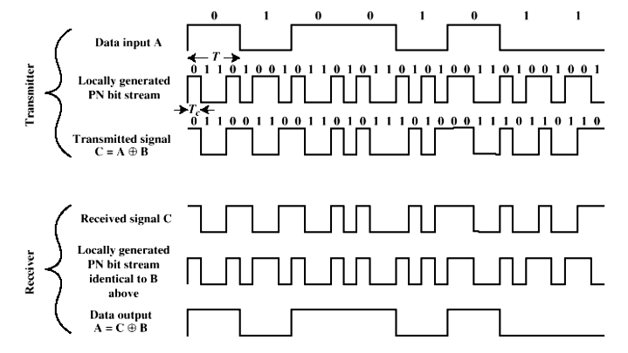
Spread Spectrum: PN Sequence

Slide 40
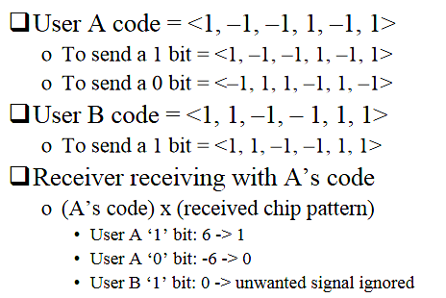
Spread Spectrum: Orthogonal Codes

Slide 41
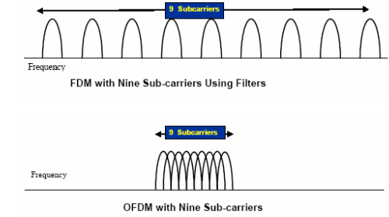
Orthogonal Frequency Division Multiplexing

Slide 42
Orthogonal Frequency Division Multiplexing
The benefits of OFDM are
high spectral efficiency,
resiliency to RF interference, and
lower multi-path distortion.
This is useful because in a typical terrestrial broadcasting scenario there are multipath-channels.
Since multiple versions of the signal interfere with each other (inter symbol interference (ISI)) it becomes very hard to extract the original information.

Slide 43
Orthogonal Frequency Division Multiplexing
OFDM is a transmission technique that has been around for years, but recently became popular due to the development of DSPs that can handle its heavy digital processing requirements.
OFDM is being implemented in BWA systems to overcome wireless transmission problems and to improve bandwidth.
OFDM is also used in wireless LANs as specified by the IEEE 802.11a and the ETSI HiperLAN/2 standards.
It is also used for wireless digital radio and TV transmissions, particularly in Europe.
OFDM is sometimes called multicarrier or discrete multi-tone modulation.

Slide 44
Orthogonal Frequency Division Multiplexing
OFDM is similar to FDM but much more spectrally efficient by spacing the sub-channels much closer together (until they are actually overlapping).
This is done by finding orthogonal frequencies i.e. perpendicular to each other in mathematical sense, allowing the spectrum of each sub-channel to overlap another without interfering

